Slide 1





BYTE THEBULLET
TEAM MEMBERS:
Bhavleen
Iqman
Jatin
Moksh
Pritish
Simarpreet
PROJECT PROPOSAL
Problem Statement: KVH-005 - Advanced ANPR & FRS solution
Domain: Video analytics/CCTV - Computer Vision
Description: Design and develop a technological solution that can accurately perform the Automatic Number Plate Recognition (ANPR) along with Facial Recognition from the available CCTV feeds. The solution should be able to recognize number plates that are written in typical non-standard ways using varying font styles, sizes, designs, symbols, languages etc., i.e. difficult to recognize by existing ANPR Systems.

Slide 2



ByteTheBullet
Objectives
TARGET/OBJECTIVE # 1
Our project is aimed at addressing the growing need for efficient and accurate license plate recognition systems in a wide range of applications, from law enforcement to parking management, toll collection, and even traffic management.
One of the key features of our ANPR system is its ability to recognize text written in typical non-standard ways using varying font styles, sizes, designs, symbols, languages etc., i.e. difficult to recognize by existing ANPR Systems, including those used in different countries and regions.
Number Plate Recognition
TARGET/OBJECTIVE # 2
Feeding the details into a database.
TARGET/OBJECTIVE # 3
Displaying the details from the database onto a website.

Slide 3





ByteTheBullet
Applications
1
Traffic Control
2
State Security
3
4
Vehicle Theft Prevention
Crime Control
5
Smart Parking
6
Toll Collection

Slide 4




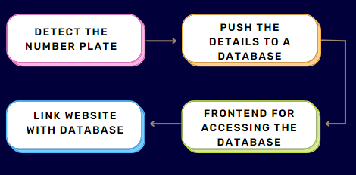


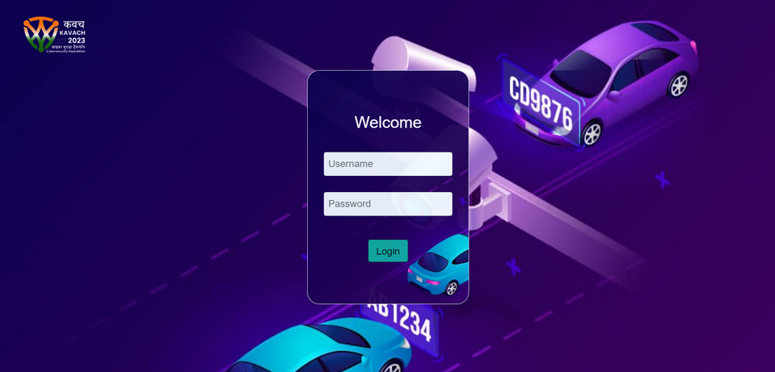

Back to Agenda
Solution
TECH STACK

